Slide 1
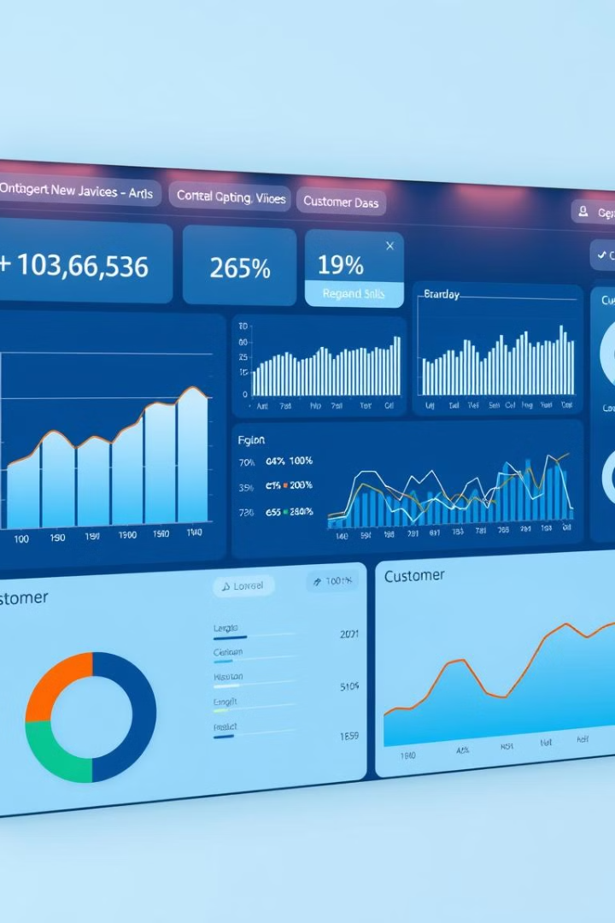
Churn Meter: Predict and Retain Customers
Churn prediction helps businesses identify customers likely to leave, enabling them to take action to retain them. It's a powerful tool for improving customer loyalty and reducing costs.

Slide 2


Slide 3

What is Churn Prediction?
1
Identifying At-Risk Customers
2
Proactive Strategies
3
Improving Retention
Businesses can proactively address customer concerns and offer incentives.
By understanding the reasons behind churn, businesses can implement strategies to retain customers.
Churn prediction uses data to identify customers who are at risk of leaving.

Slide 4
Key Benefits of Churn Prediction
Improved Retention
Cost Savings
Enhanced Customer Relationships
Churn prediction helps businesses identify customers who are at risk of leaving, allowing them to take action to retain them.
It's generally cheaper to retain existing customers than to acquire new ones.
By proactively addressing customer concerns, businesses can build stronger and more lasting relationships.

Slide 5





Improved Retention
Identify At-Risk Customers
Proactive Outreach
Personalized Solutions
Churn prediction models pinpoint customers who are likely to churn.
Businesses can reach out to these customers to address their concerns.
Offering incentives and tailored solutions can help retain customers.

Slide 6

Cost Savings
Customer Acquisition
Customer Retention
High marketing costs
Lower costs overall
Uncertainty of new customer loyalty
Proven customer value and loyalty

Slide 7

Predictive Analytics Techniques
Regression Analysis
Machine Learning
Predicts churn based on historical data and customer characteristics.
Utilizes algorithms to learn patterns and predict future churn.
Decision Trees
Creates a tree-like structure to classify customers based on their risk of churn.

Slide 8

Building a Churn Prediction Model
1
Data Collection and Preparation
Gather relevant data from multiple sources.
2
Feature Engineering
Create meaningful features from raw data.
3
Model Selection and Training
Choose an appropriate algorithm and train it on the data.
4
Model Evaluation and Optimization
Evaluate the model's performance and fine-tune parameters.

Slide 9





Implementing Churn Prediction
System Integration
Real-Time Monitoring
Integrate the model into existing customer relationship management (CRM) systems.
Continuously monitor churn predictions and identify at-risk customers.
Actionable Insights
Continuous Improvement
Use predictions to develop targeted retention strategies and campaigns.
Regularly review and refine the model for improved accuracy and effectiveness.

Slide 10

Project Demonstation

Slide 11
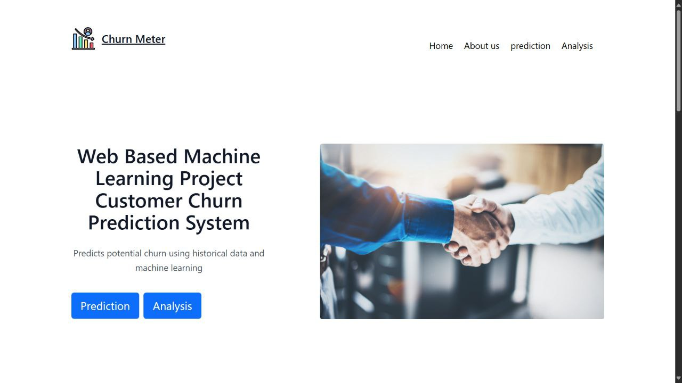

Slide 12
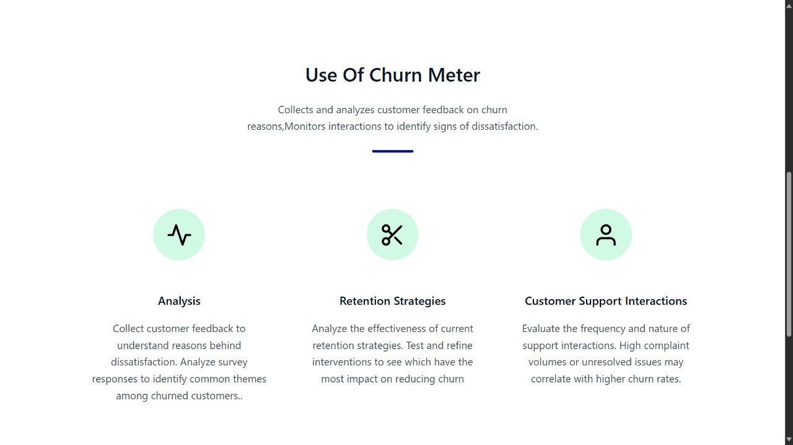

Slide 13
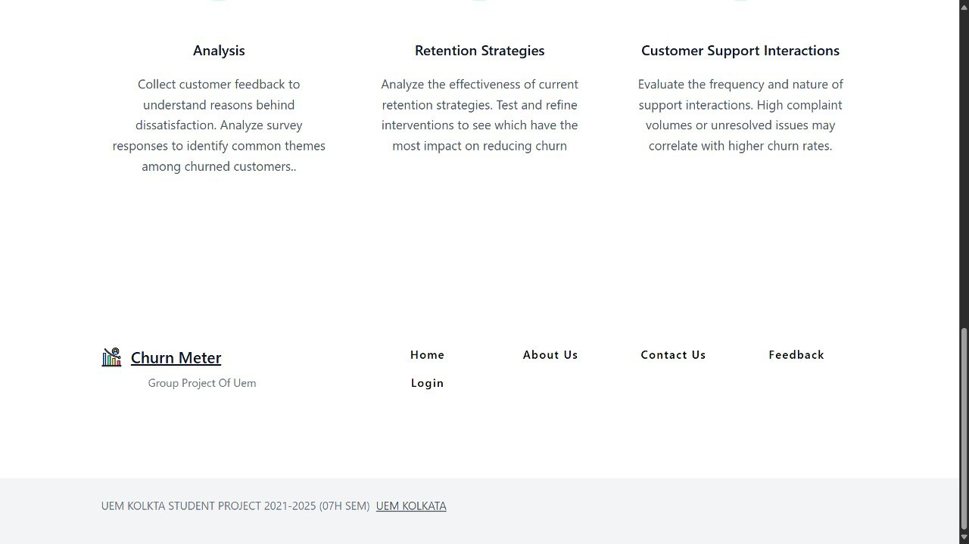

Slide 14
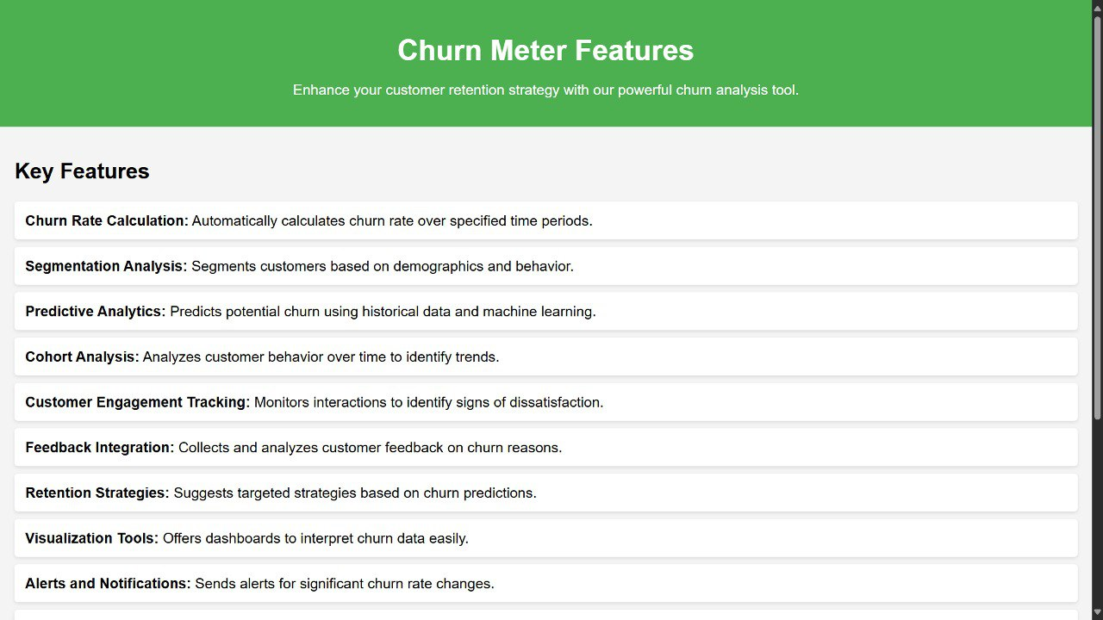

Slide 15
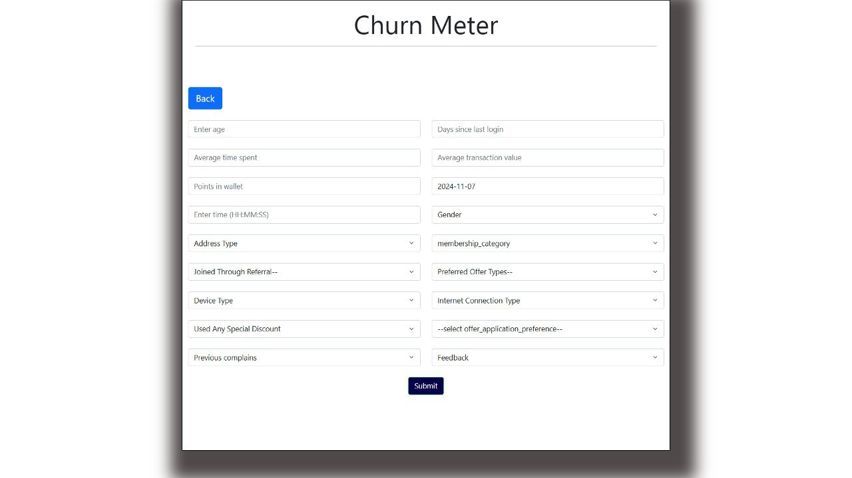

Slide 16
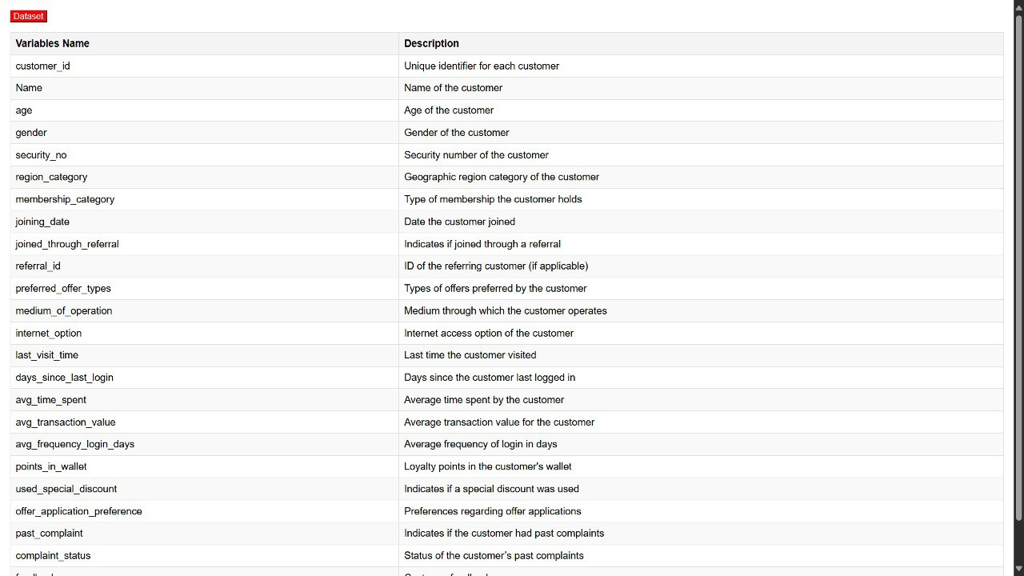

Slide 17
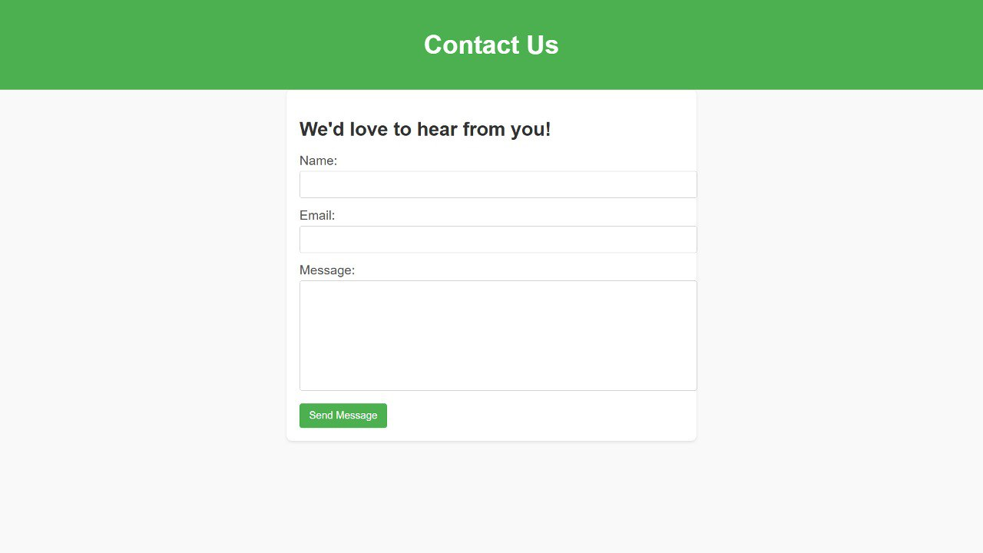

Slide 18
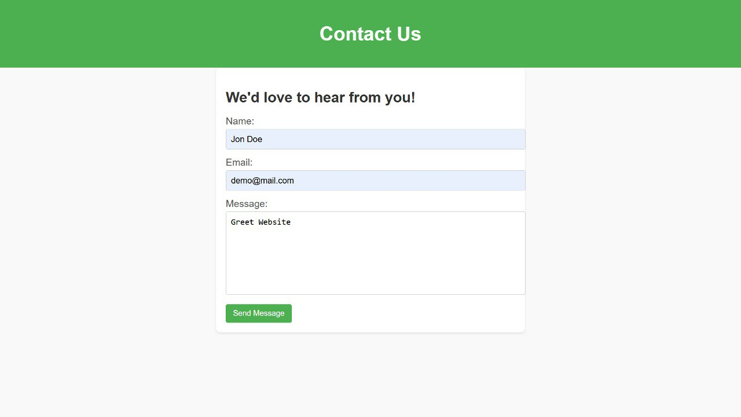

Slide 19
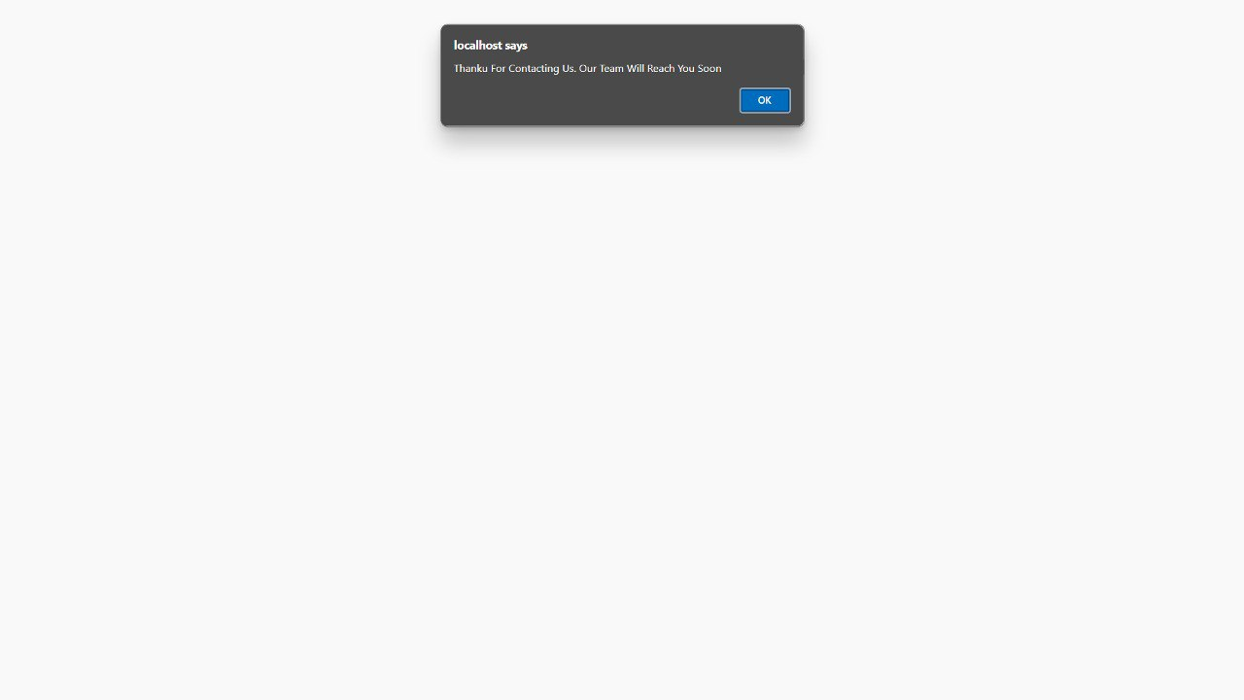

Slide 20
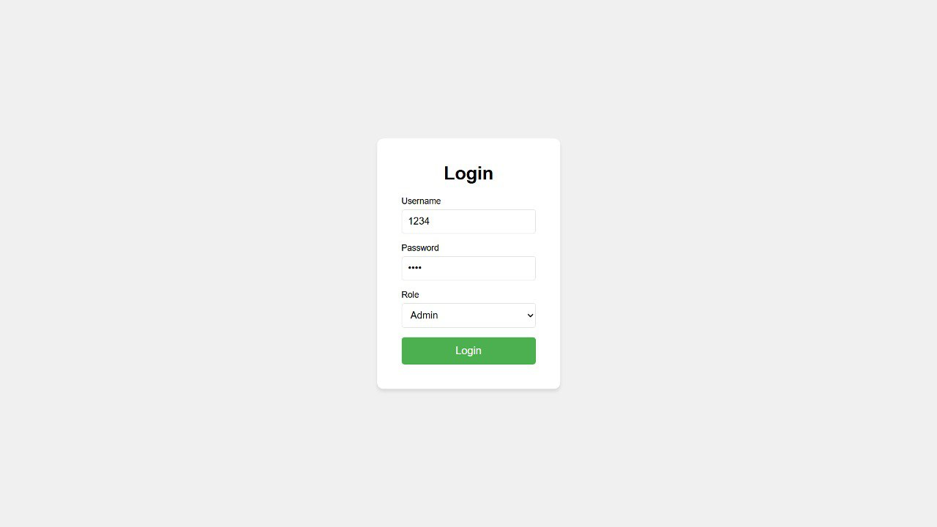

Slide 21
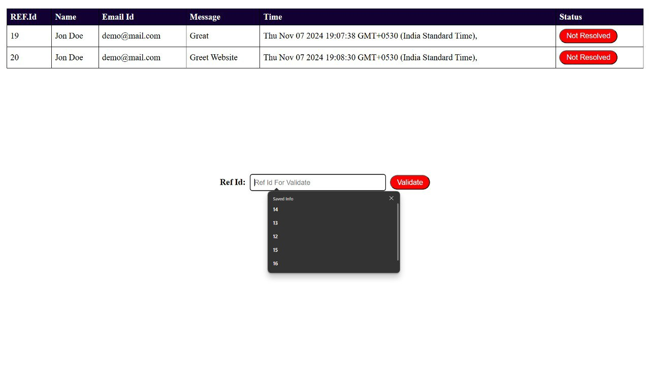

Slide 22
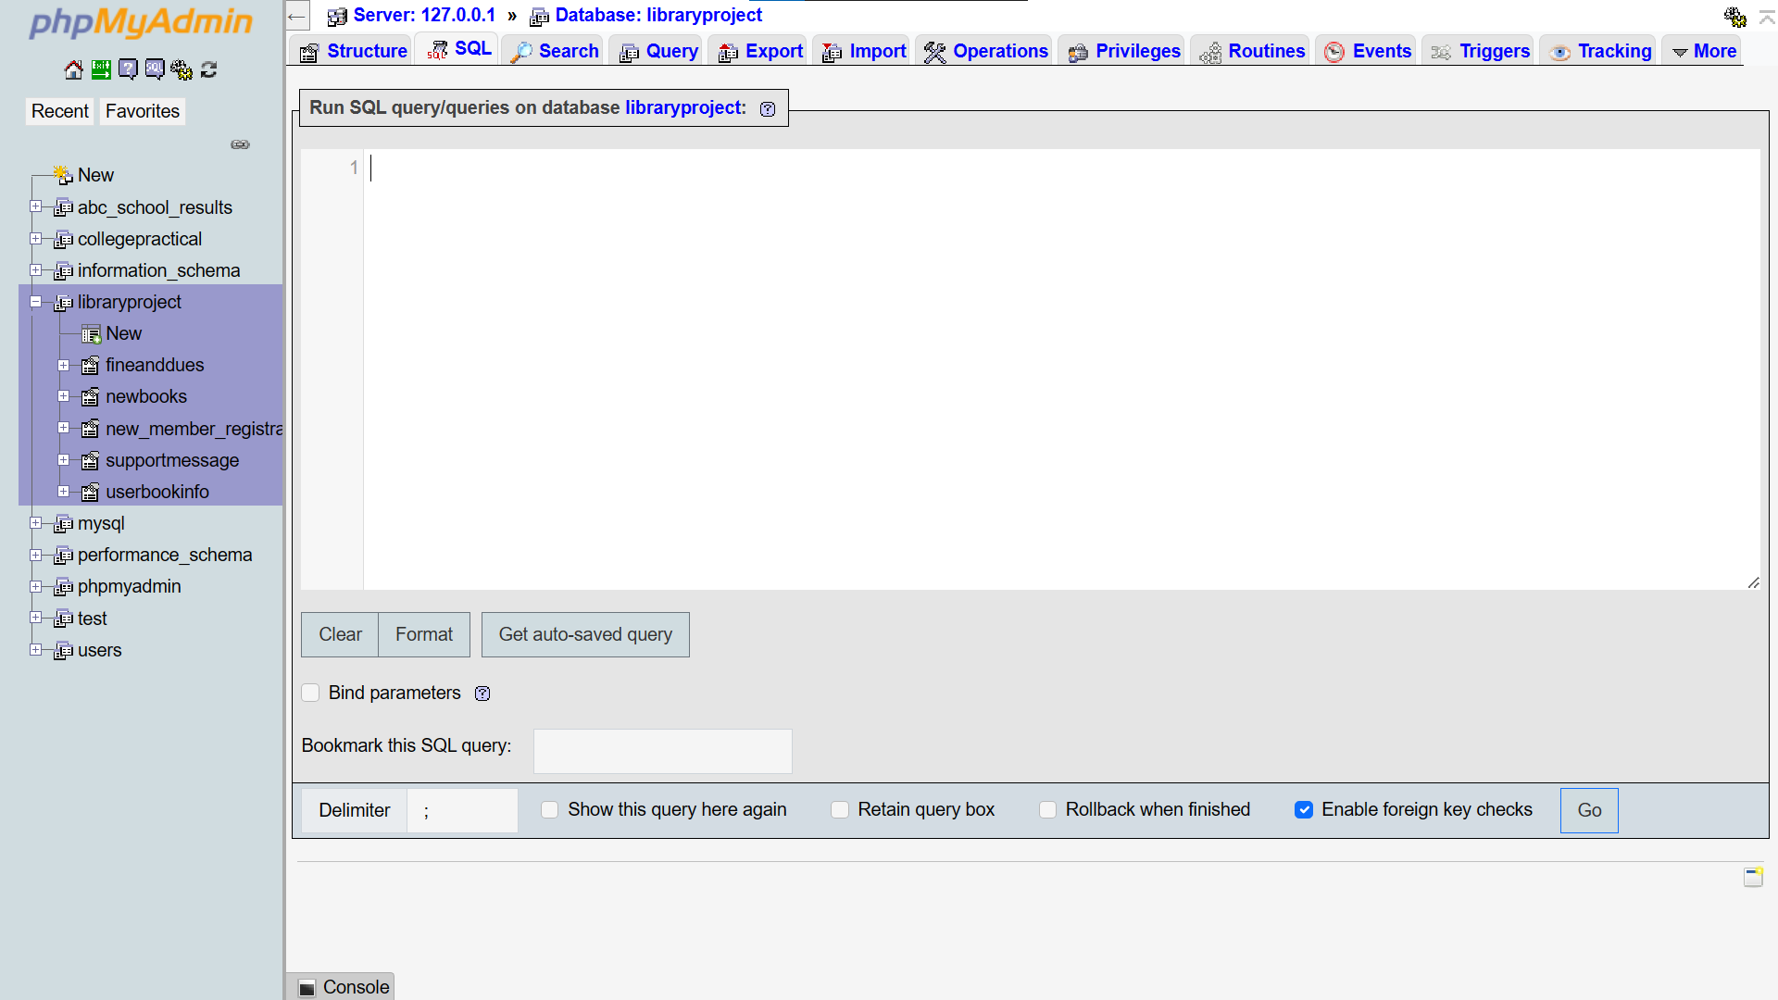

Slide 23
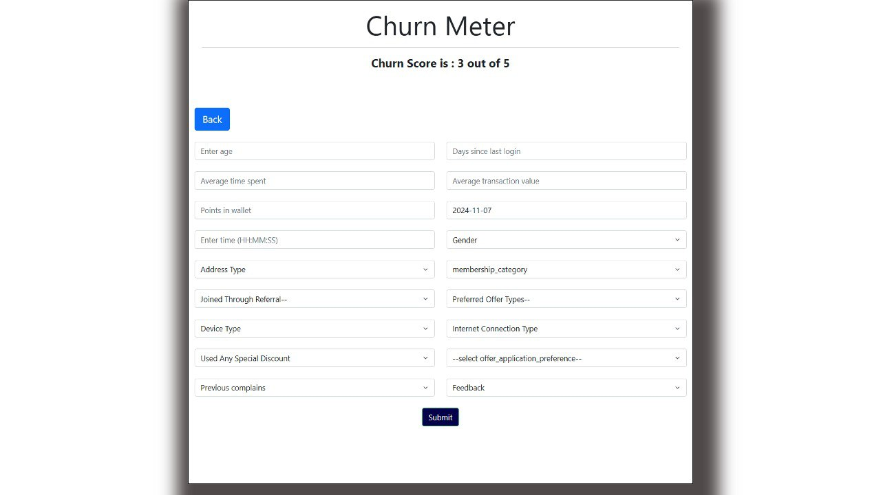

Slide 24
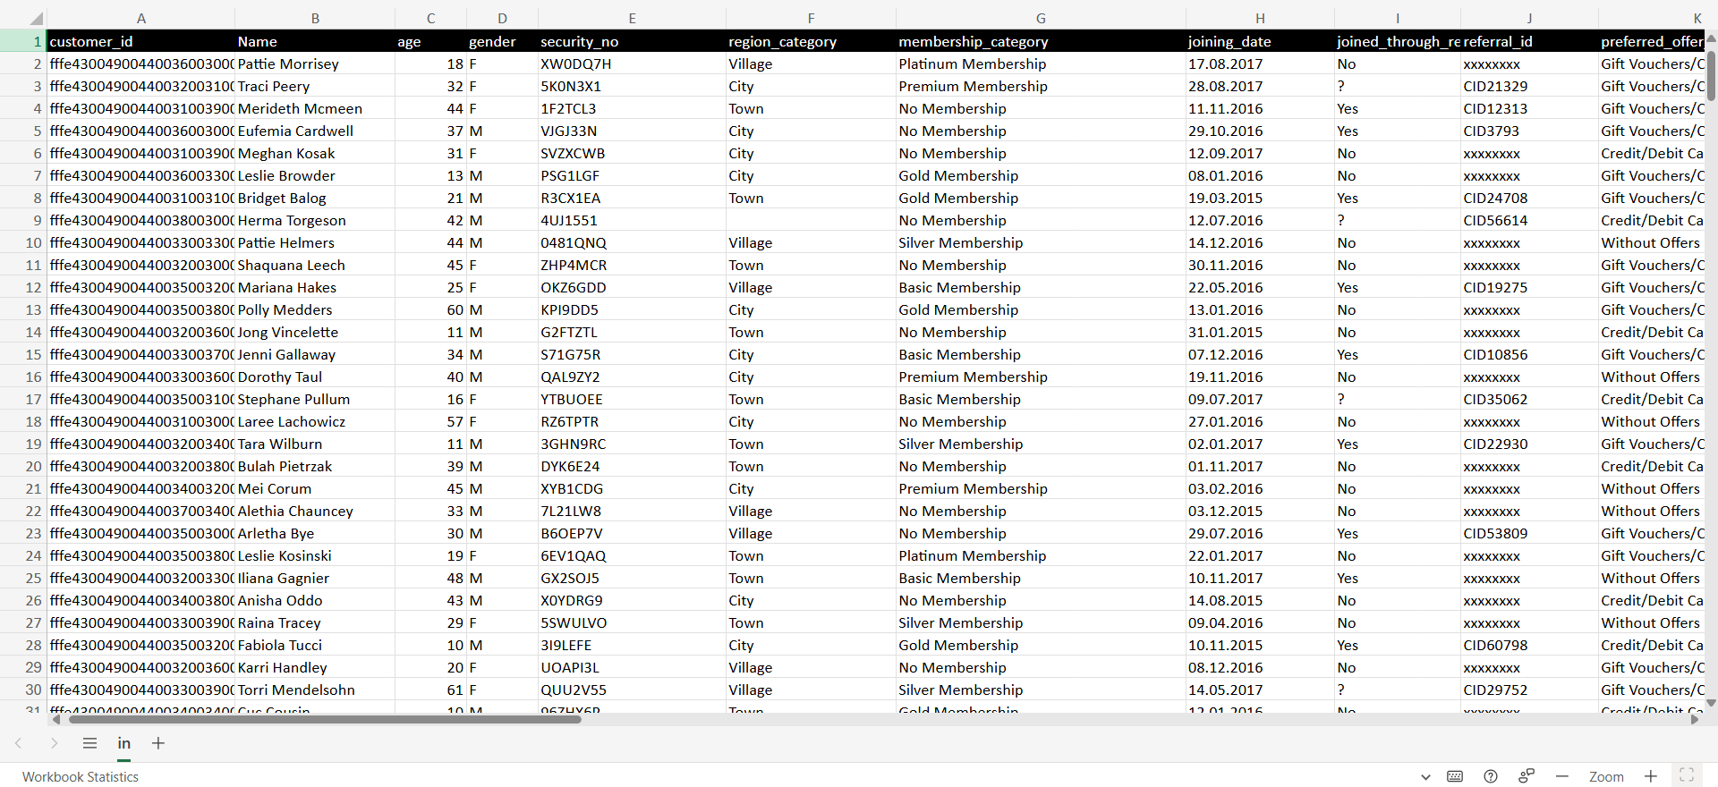

Slide 25
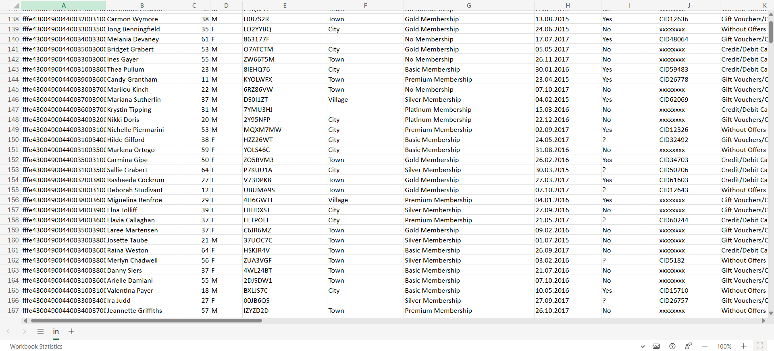

Slide 26
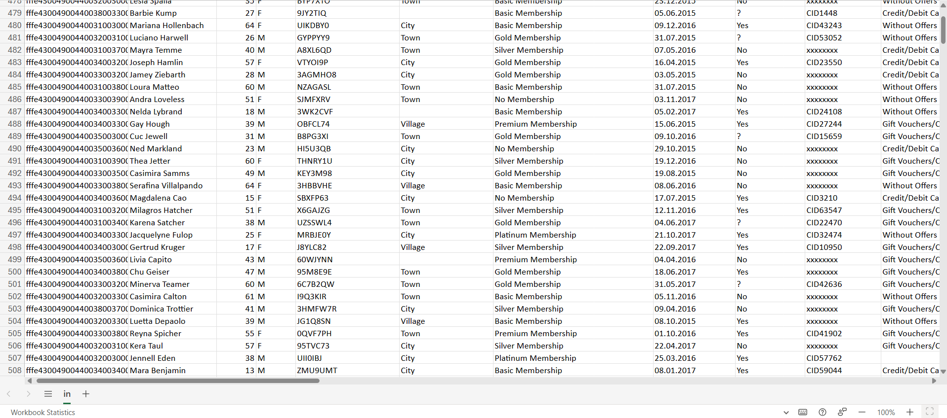

Slide 27









Tools And Technology Used

Slide 28
Future Enhancement
Enhance churn reporting with sophisticated visualizations, such as heatmaps, trend analysis, and cohort-based tracking, so businesses can quickly spot patterns and take action.
Develop predictive dashboards that show likely future churn trends and let teams model different "what-if" scenarios (e.g., "What if we improved feature X for this customer segment?"). These insights will help decision-makers take informed actions before churn becomes a serious issue.
Develop more granular engagement scores that reflect the depth and quality of customer interaction, not just frequency or volume. These scores can provide early warnings of potential churn before customers disengage entirely.
As businesses increasingly rely on data-driven strategies, the future of churn prediction is poised for significant advancements, primarily driven by the integration of artificial intelligence (AI), big data analytics, and emerging technologies. These innovations are set to enhance the accuracy and efficiency of churn prediction models, providing organizations with deeper insights into customer behavior and preferences.
One of the most promising trends is the expansion of AI and machine learning. These technologies enable businesses to analyze vast datasets and uncover intricate patterns that traditional methods may overlook. Advanced algorithms can now assess a multitude of variables, such as customer interactions, sentiment analysis from social media, and even external factors like economic indicators. This holistic approach allows for a more nuanced understanding of churn triggers, enabling organizations to anticipate customer needs proactively.

Slide 29
References
"Customer Experience 3.0" by John A. Goodman
"Predictive Analytics for Dummies" by Anasse Bari, Mohamed Chaouchi, and Tommy Jung
Gartner’s Magic Quadrant for Customer Service & Support Platforms
Using Machine Learning to Reduce Churn: Best Practices" by IBM

Slide 30


